Slide 1
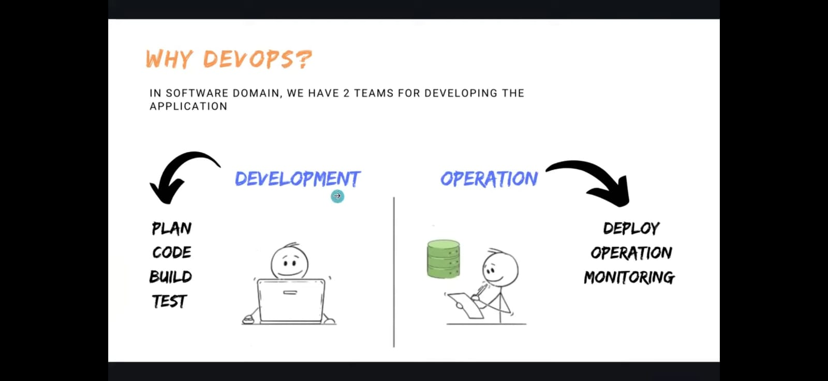

Slide 2
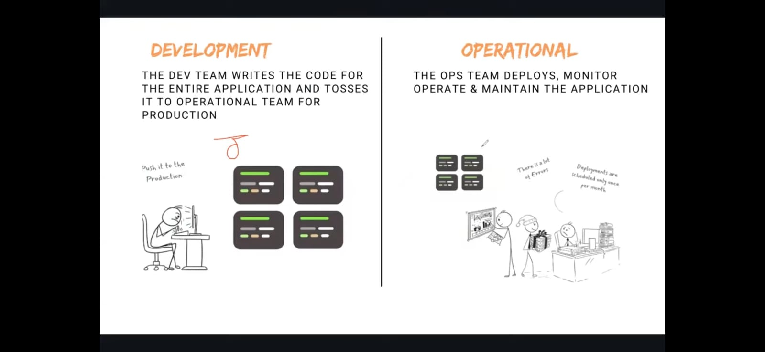

Slide 3
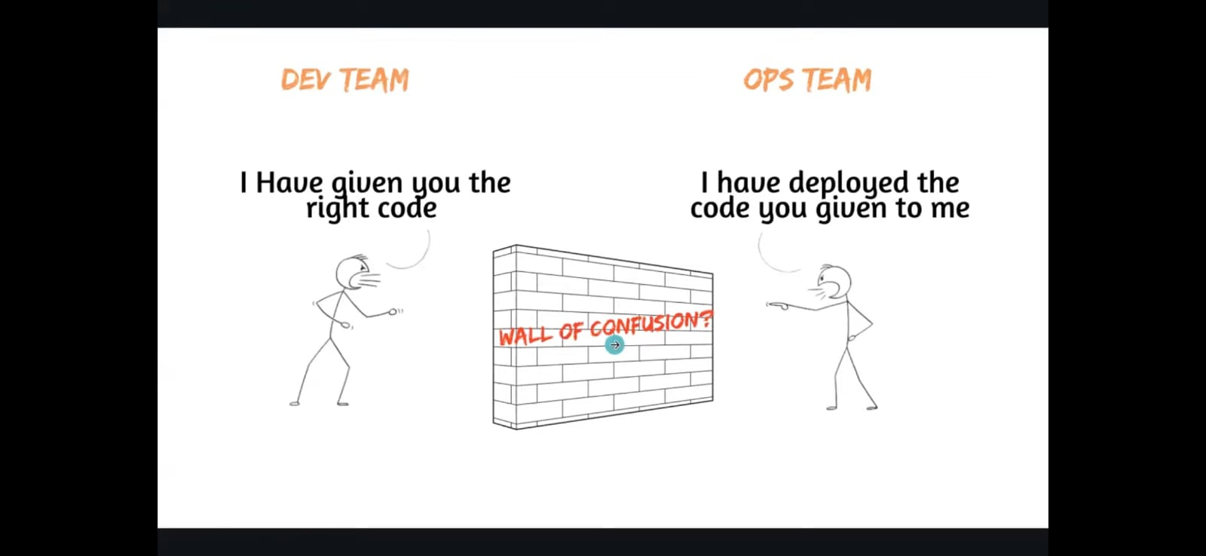

Slide 4
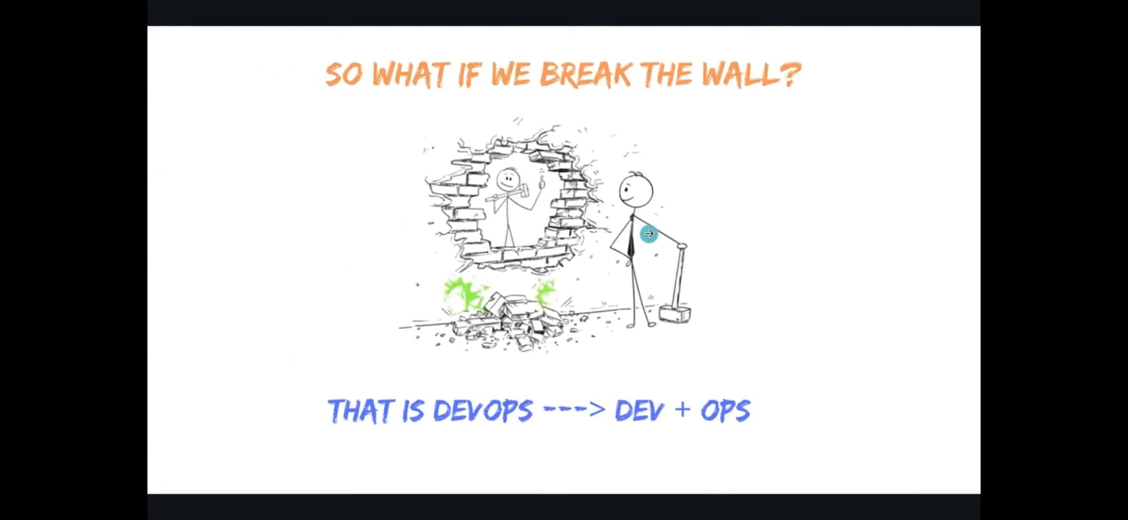

Slide 5
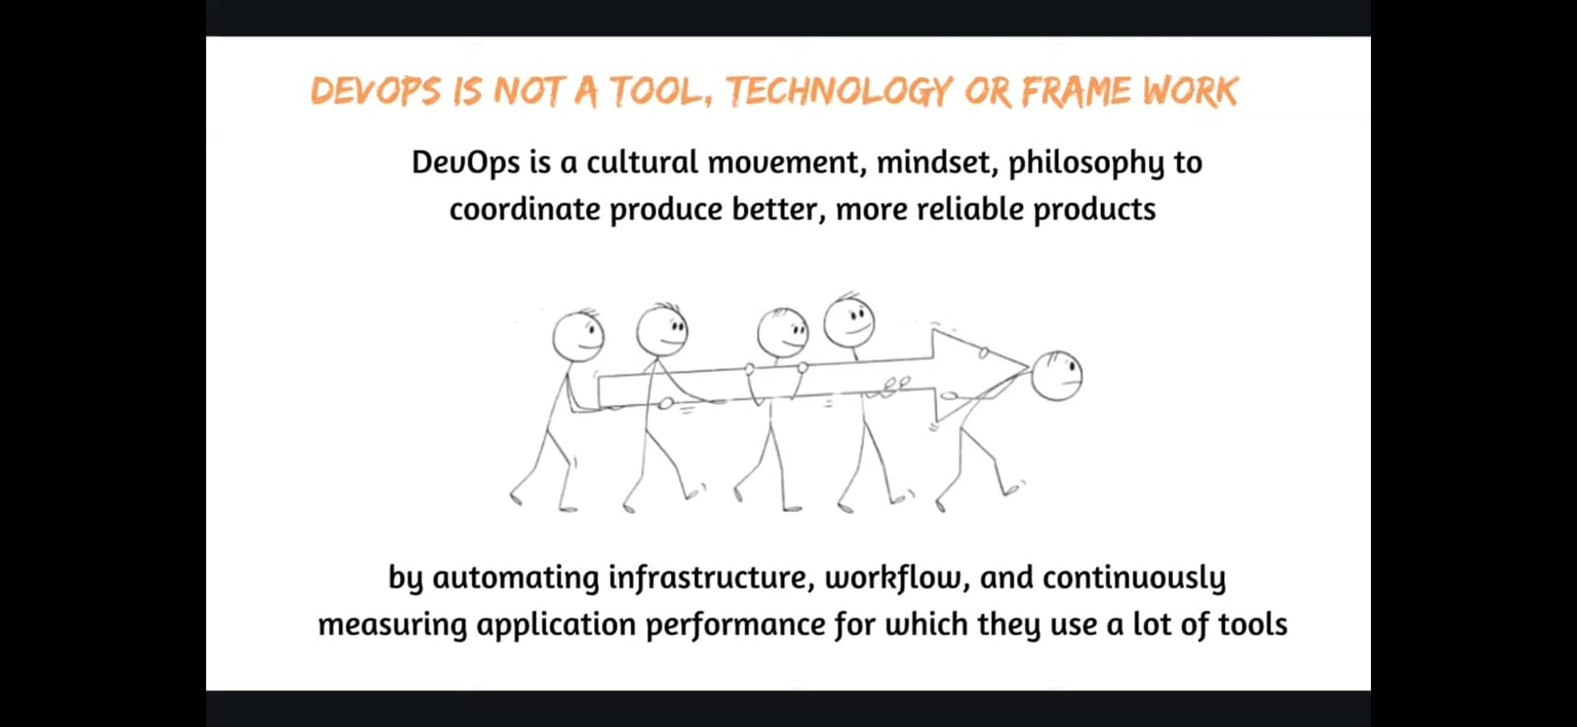

Slide 6
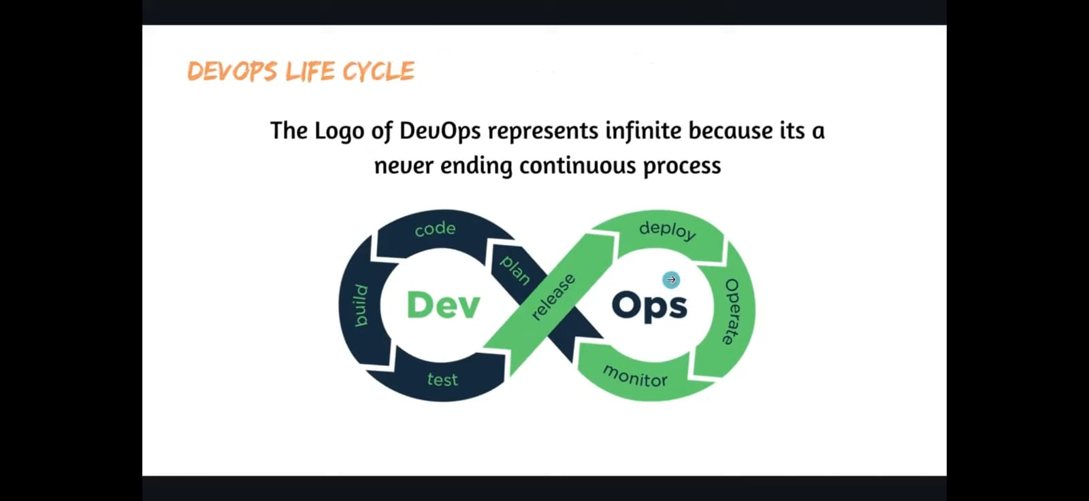

Slide 7
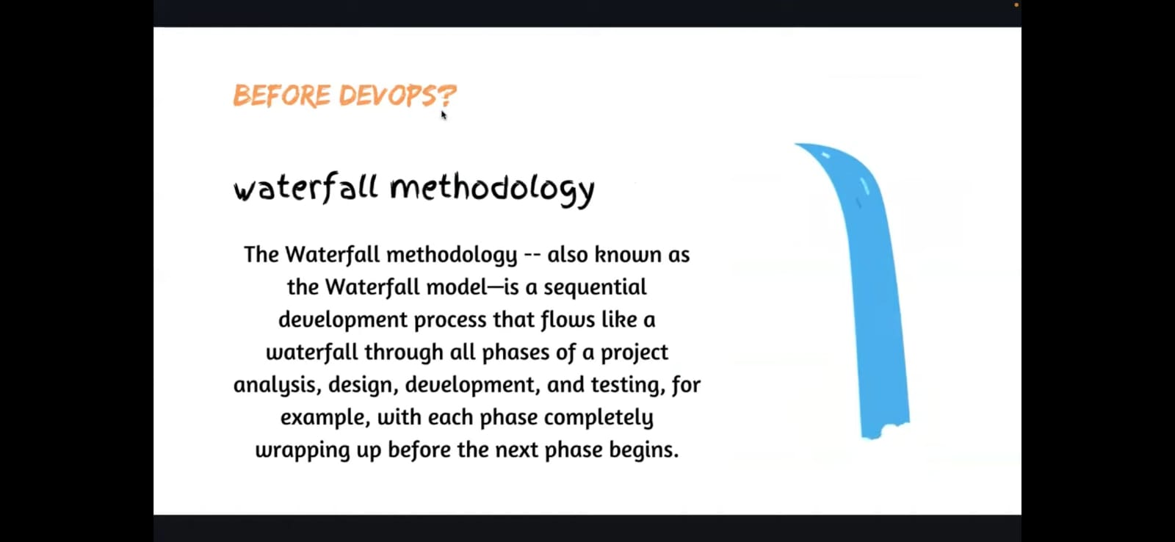

Slide 8
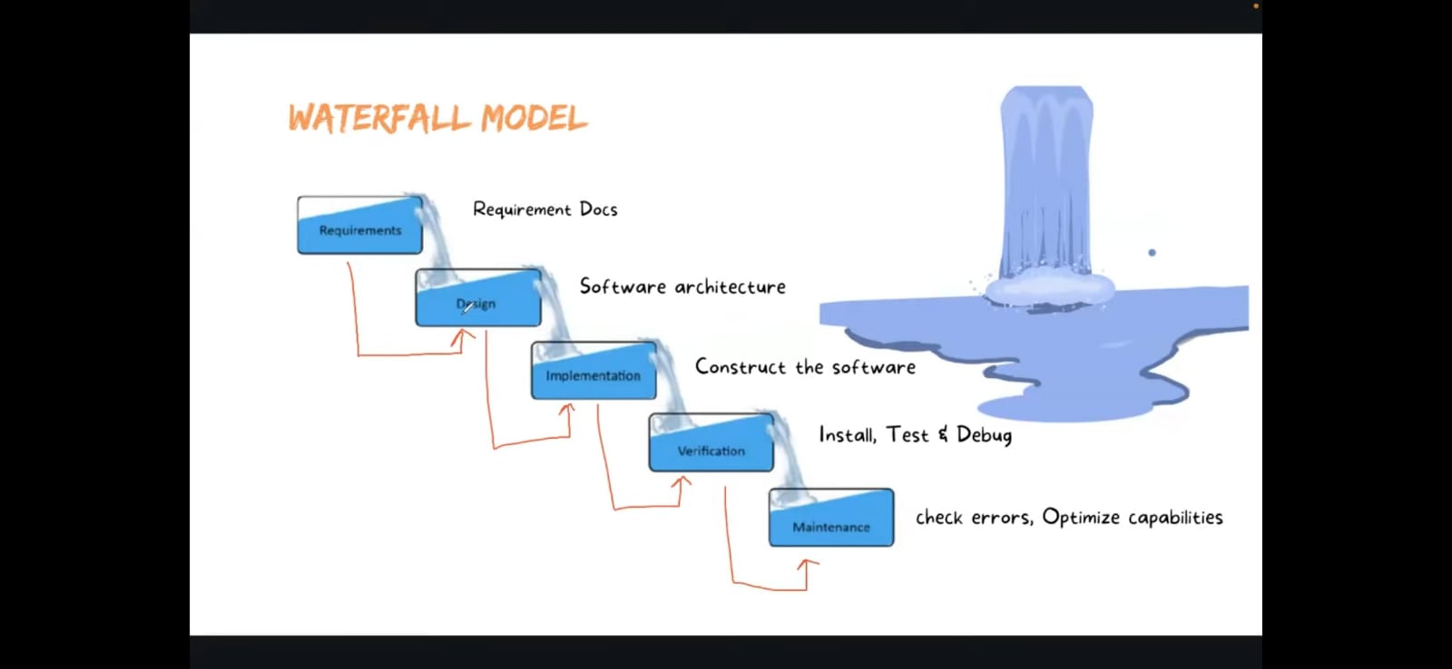

Slide 9
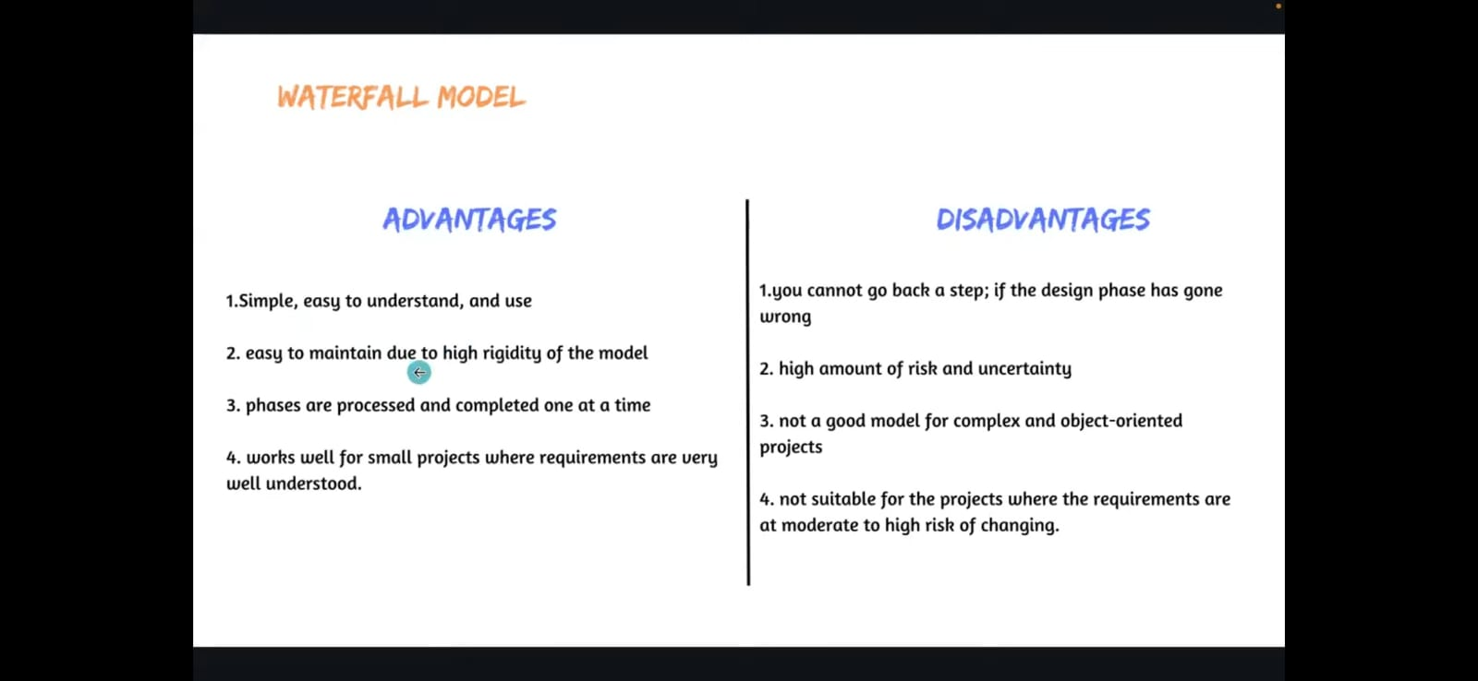

Slide 10
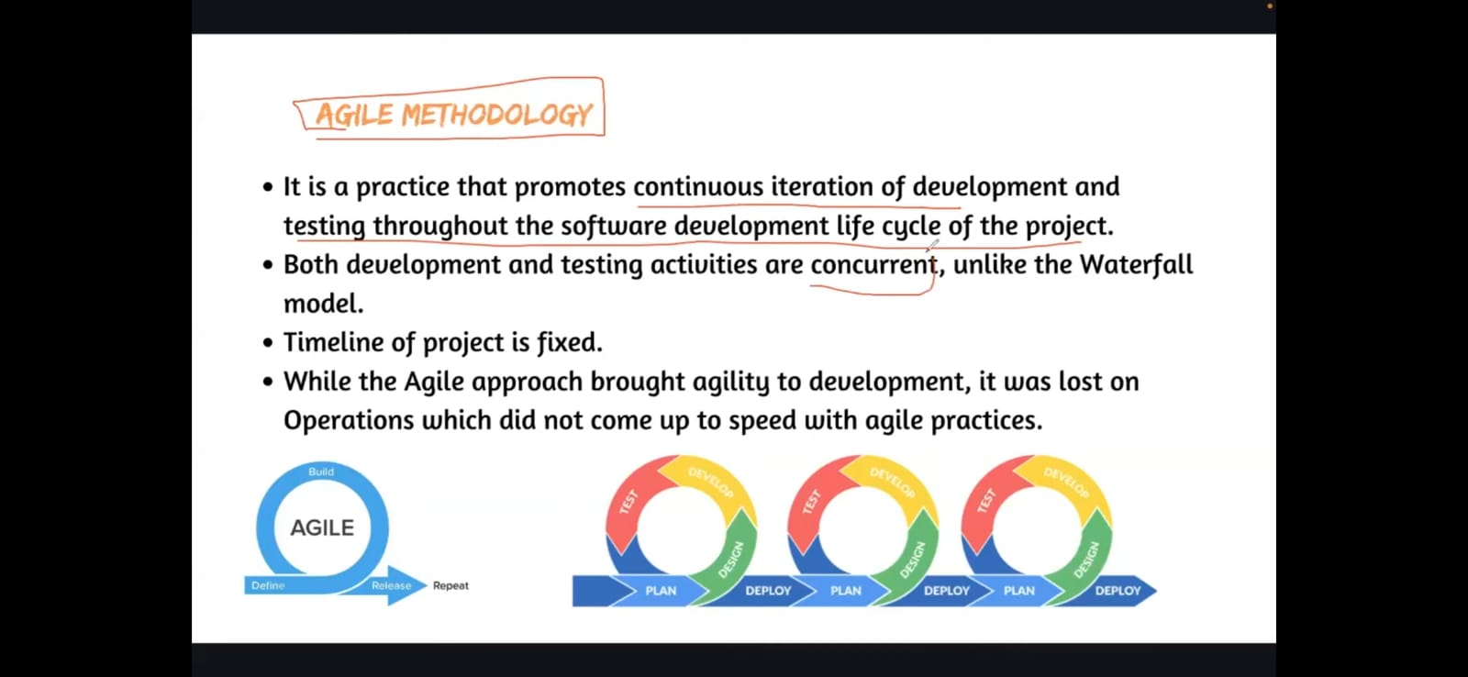

Slide 11
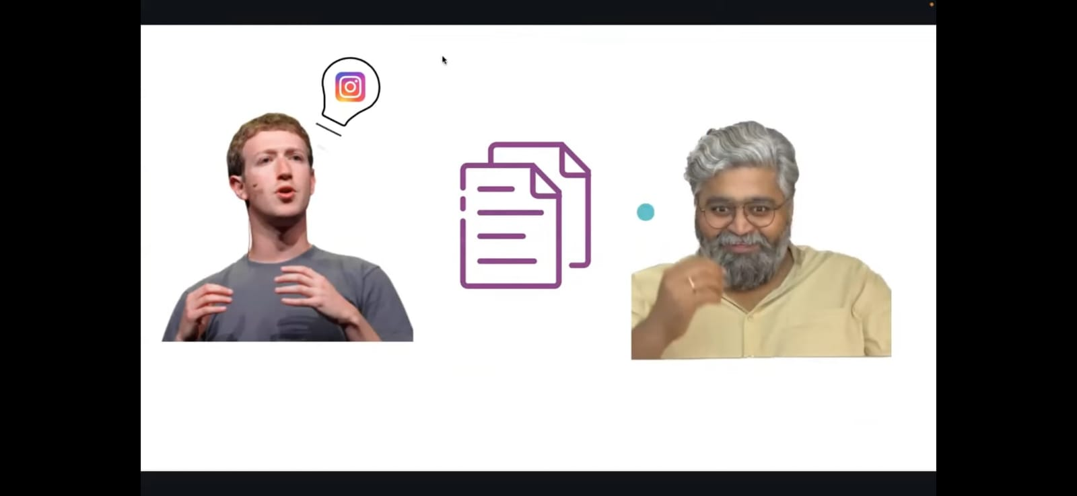

Slide 12
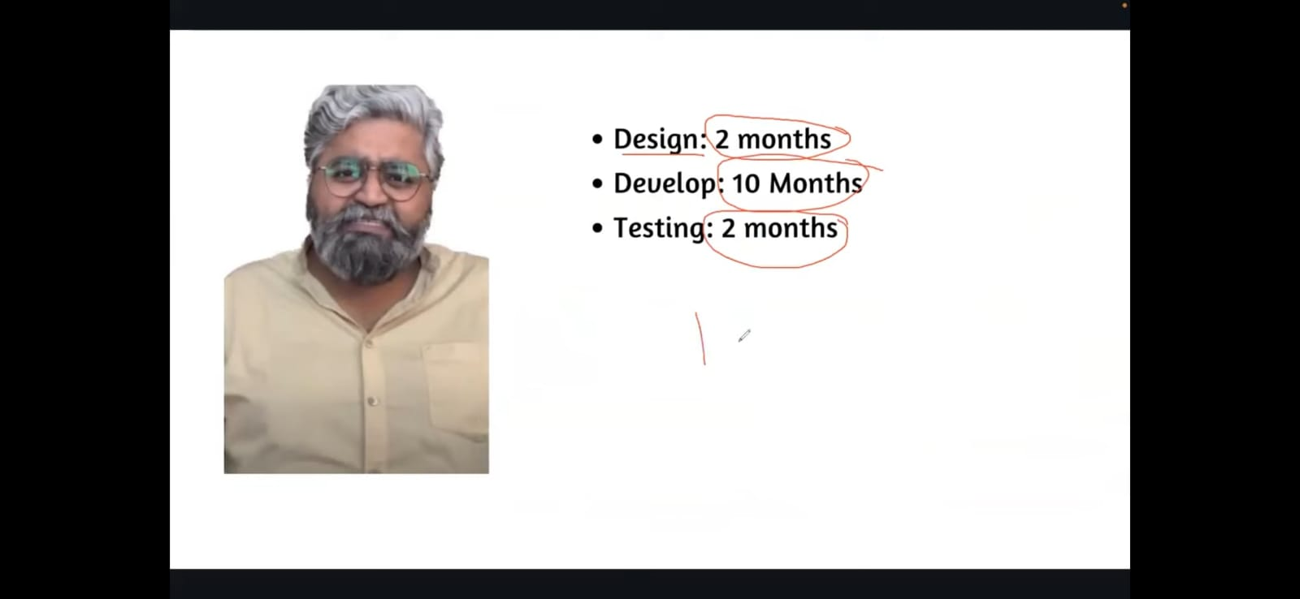

Slide 13
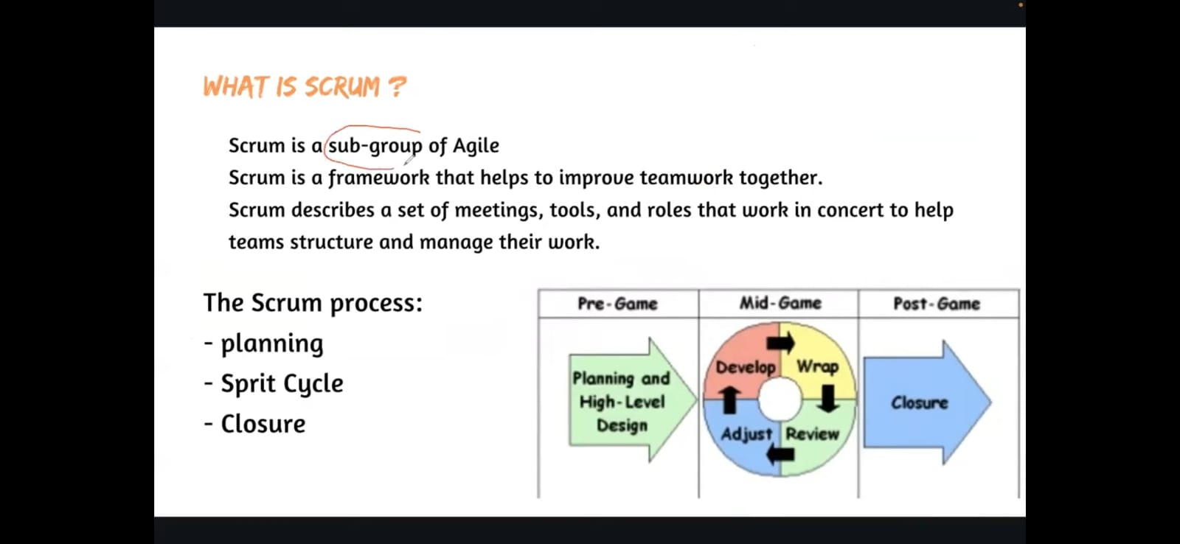

Slide 14
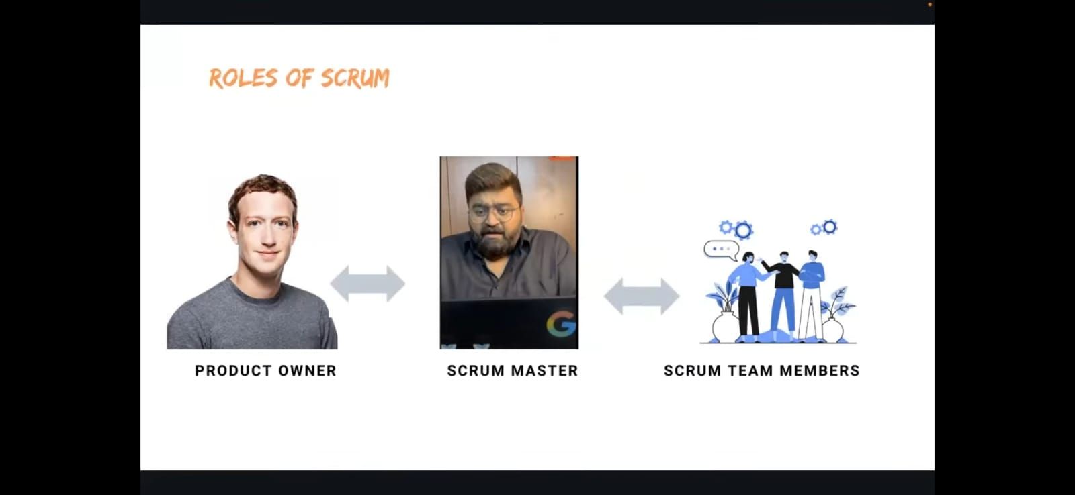

Slide 15
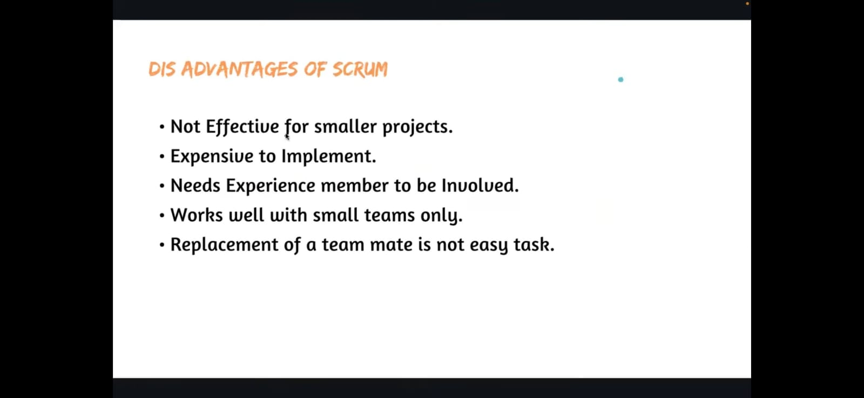

Slide 16
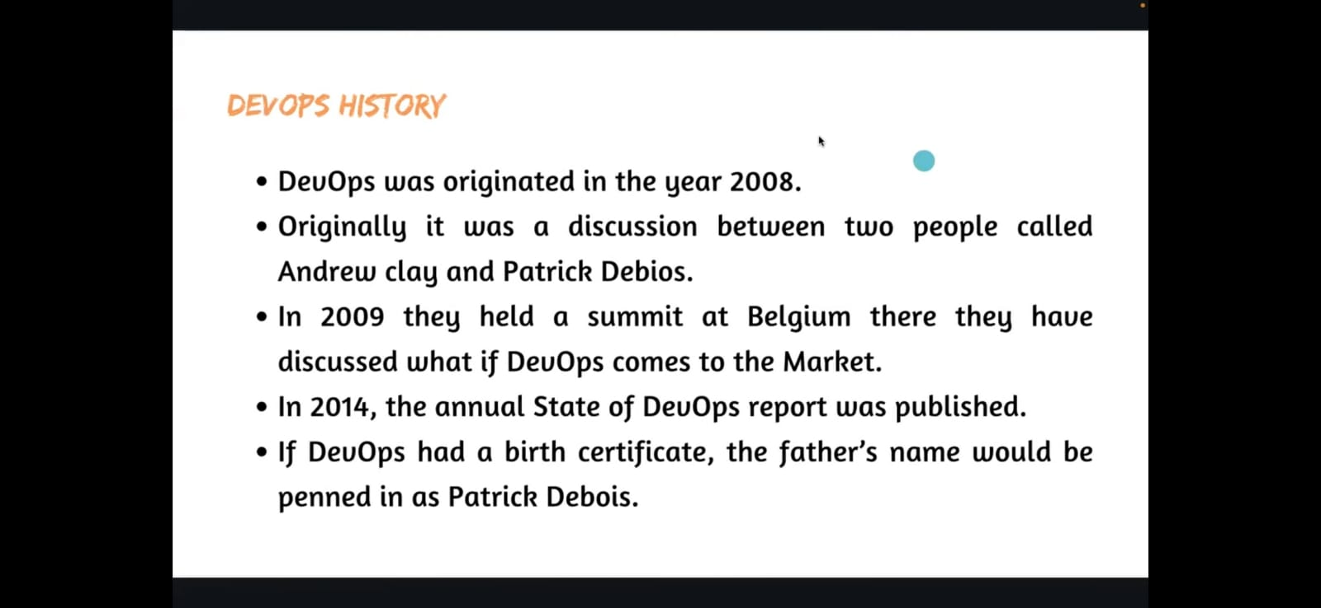

Slide 17
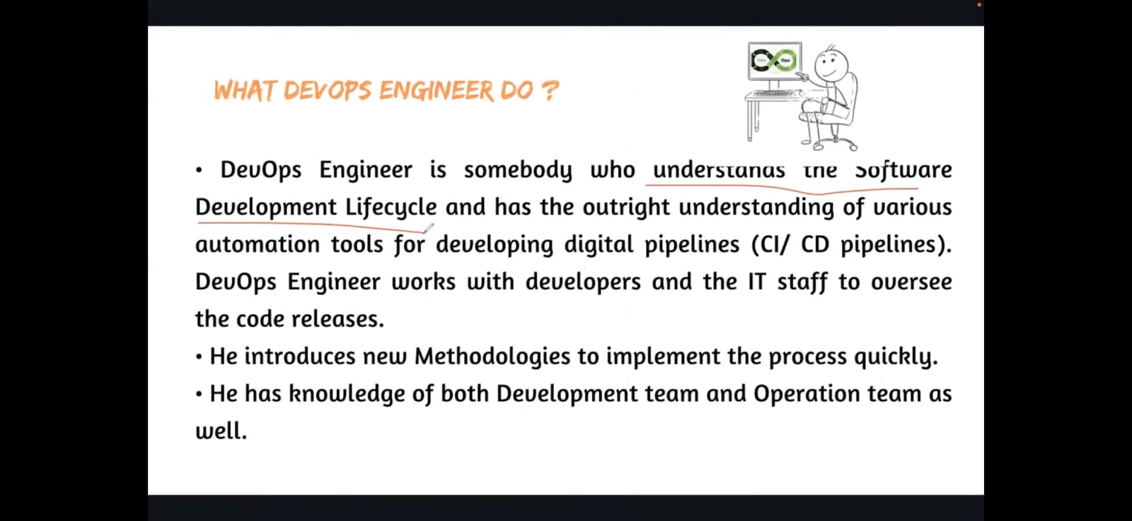

Slide 18
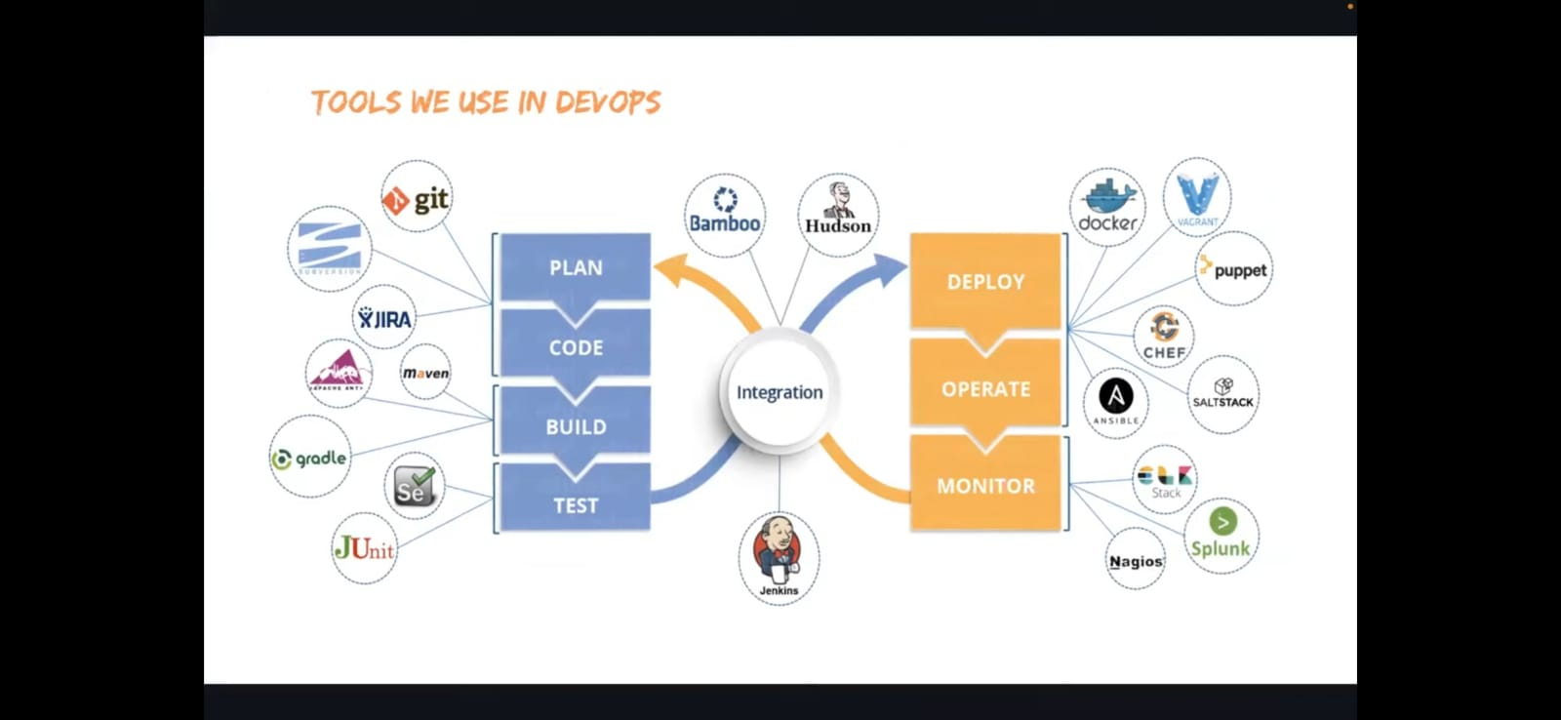

Slide 19
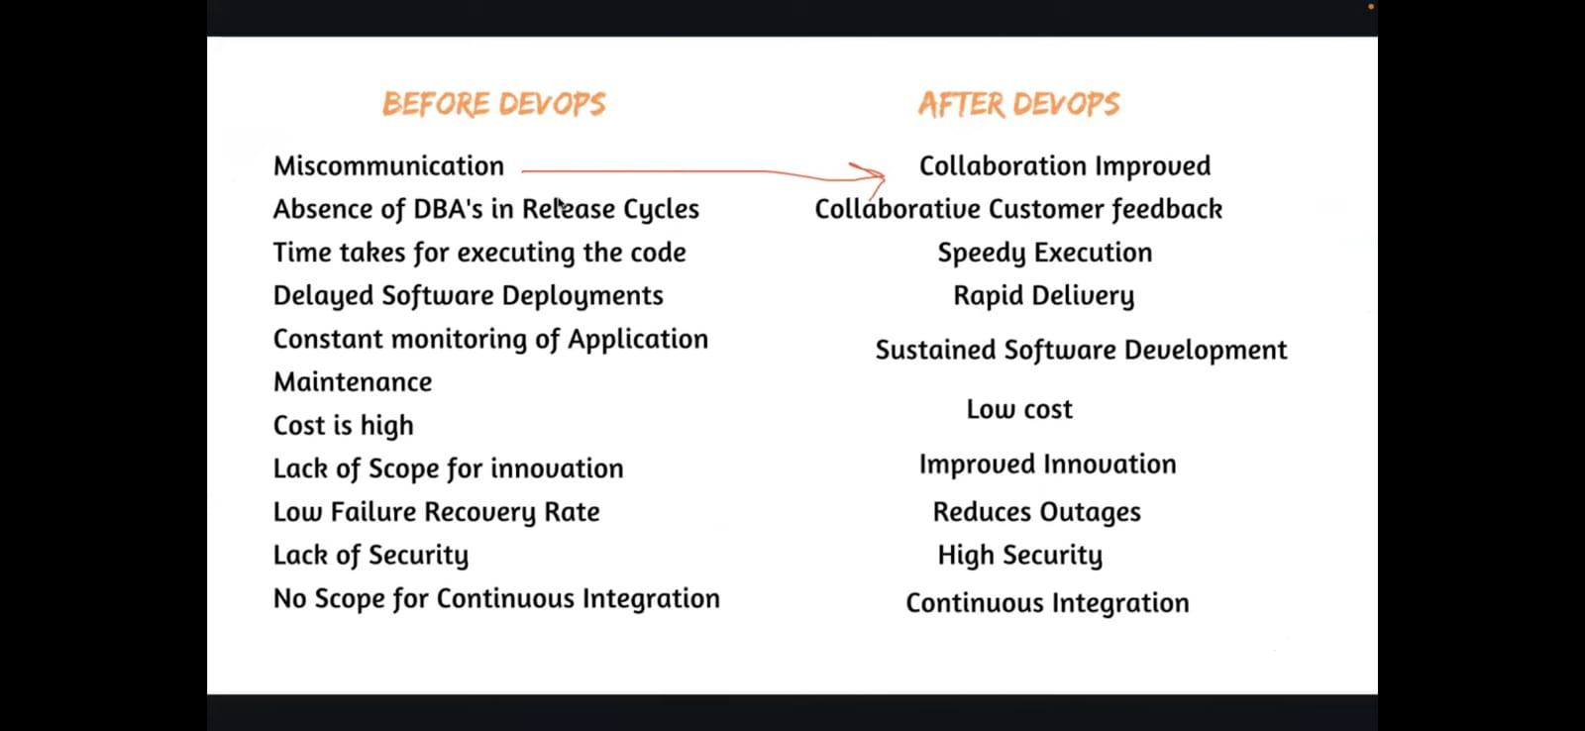

Slide 20
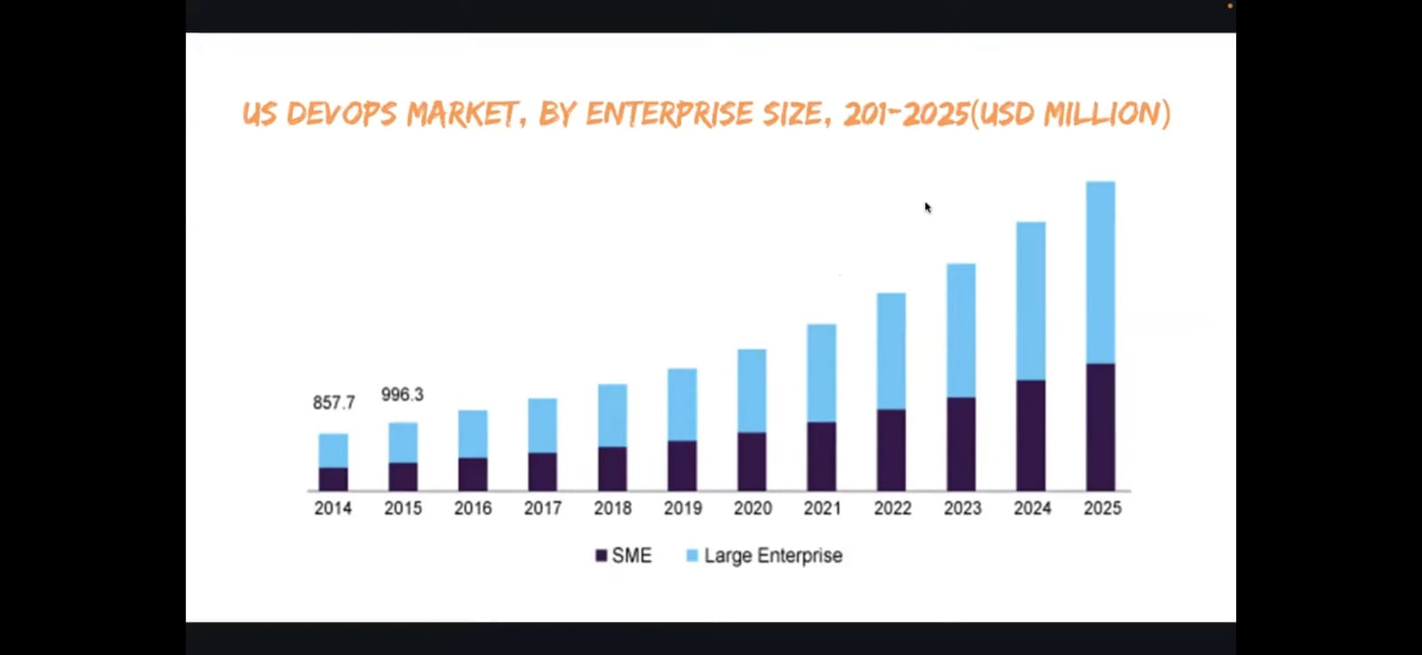

Slide 21
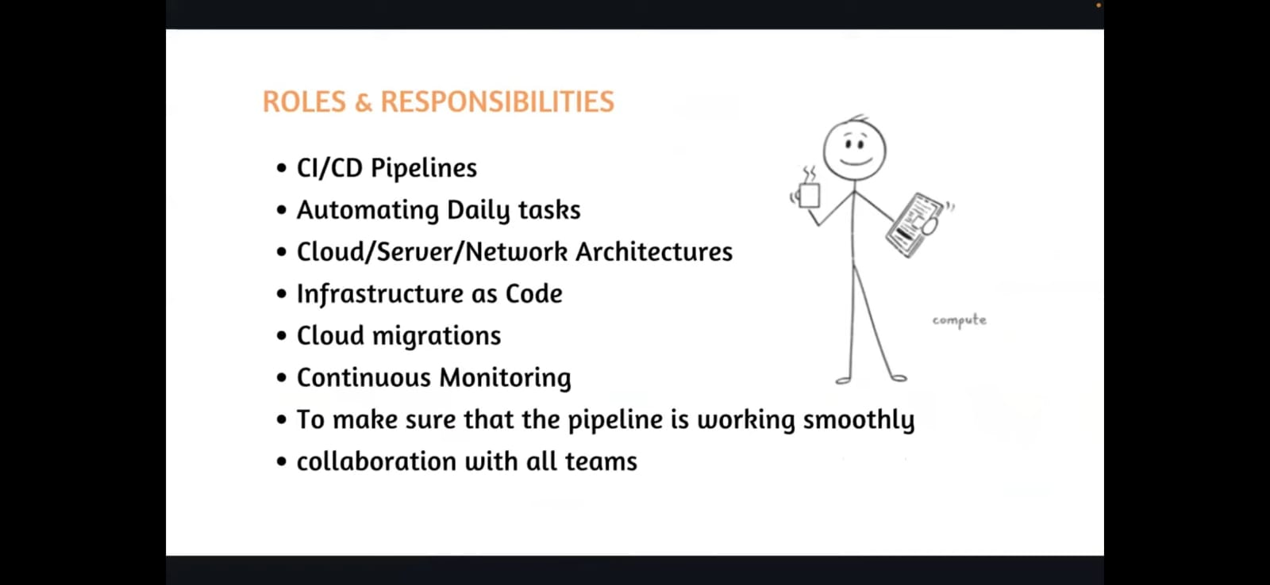

Slide 22
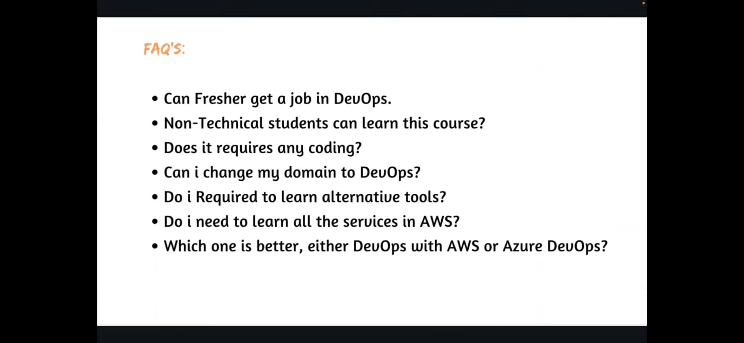

Slide 23
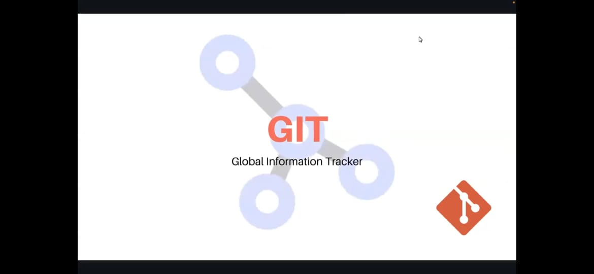

Slide 24
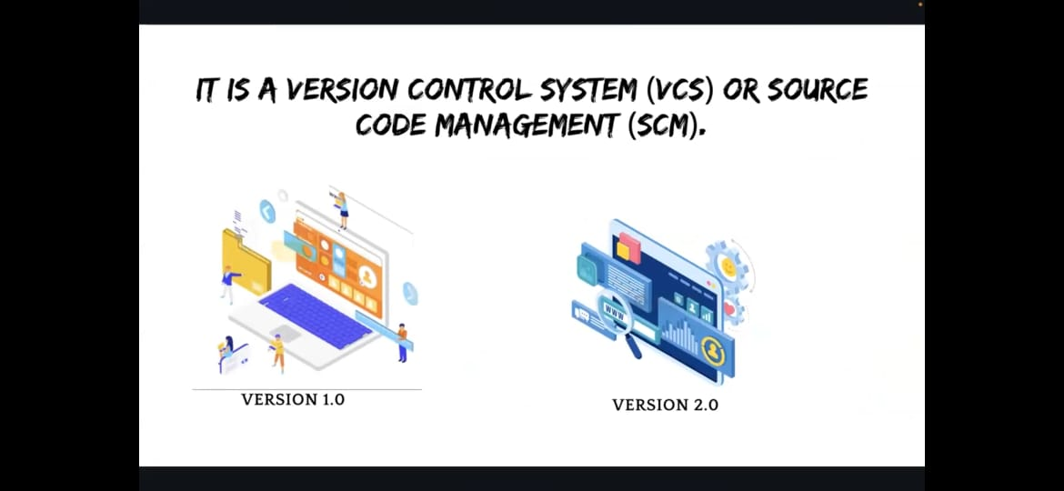

Slide 25
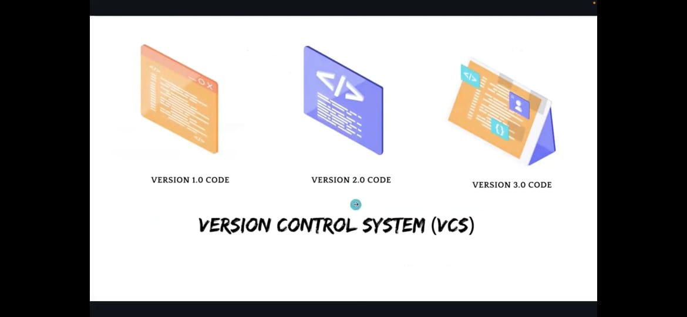

Slide 26
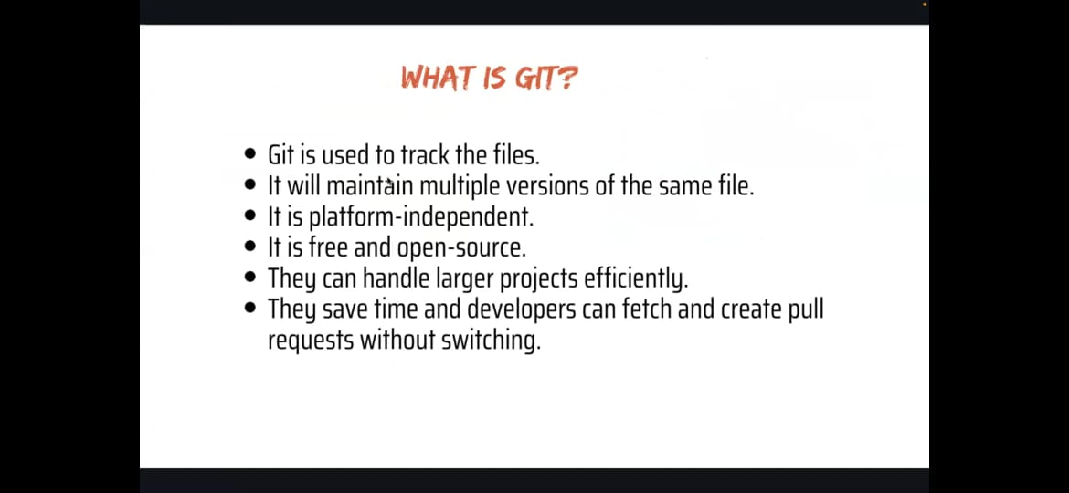

Slide 27
git
SCCM : Source code control system
RCS : Revision control system
CVS : Concurrent version system
SVN : Sub version
GIT IS 3RD Generation of VCS
Roll back means you can back before the old version
Roll out means you can switch after the latest version

Slide 28
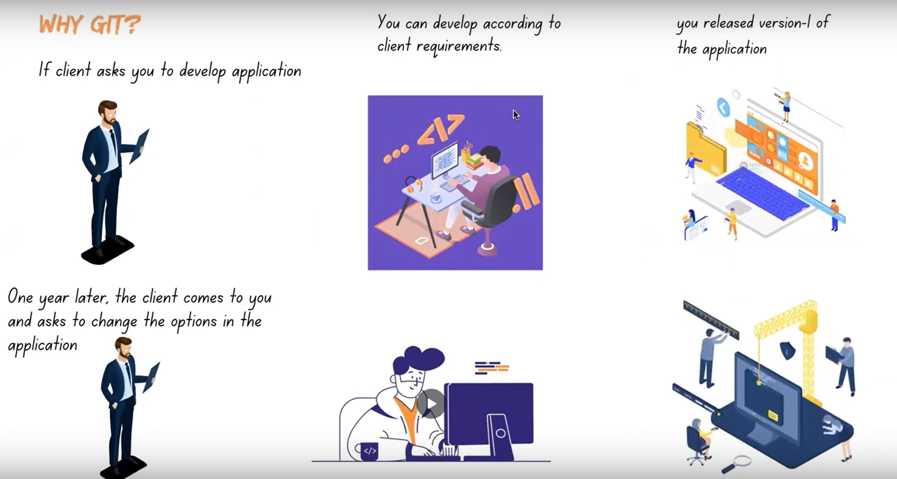

Slide 29
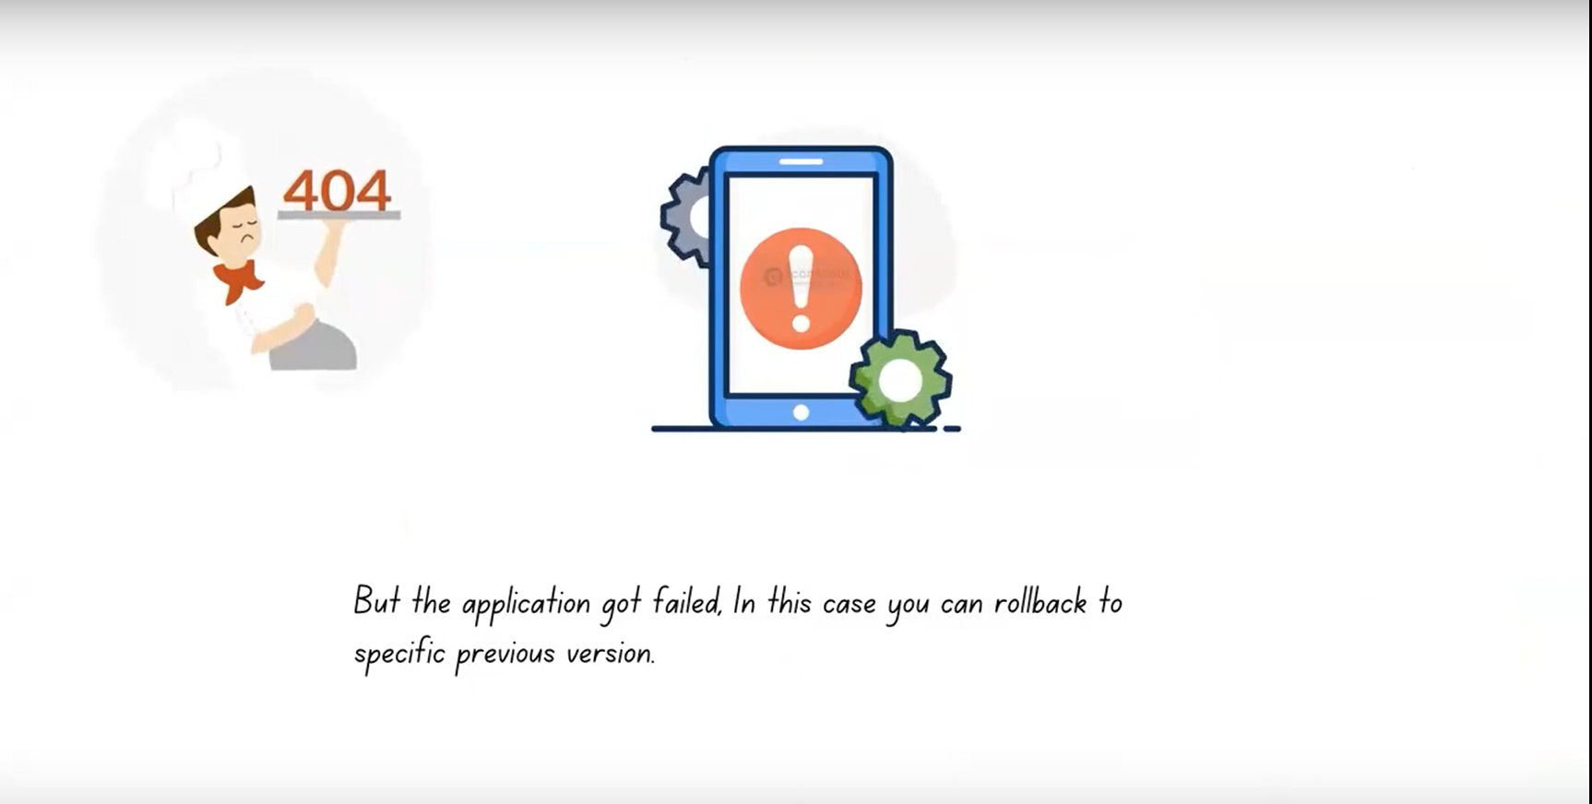

Slide 30
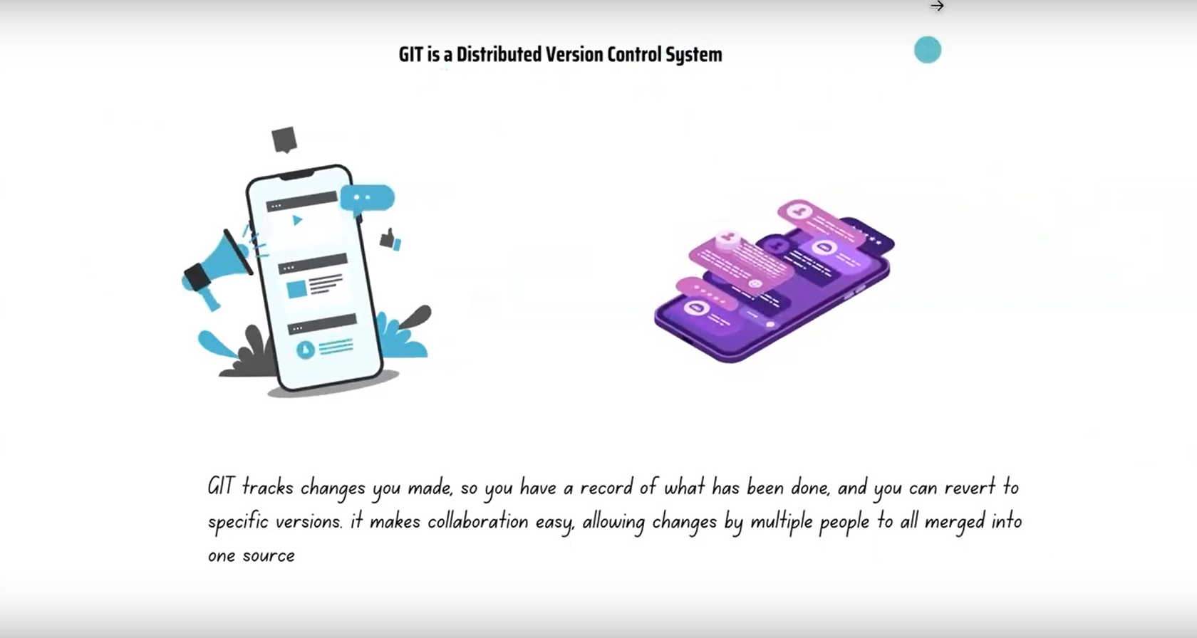

Slide 31
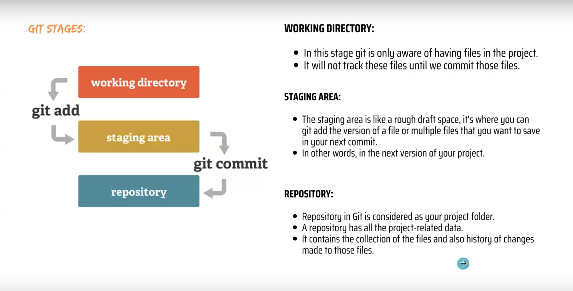

Slide 32
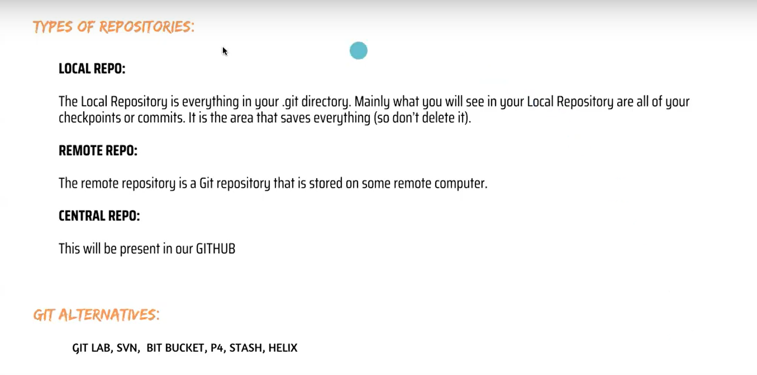

Slide 33
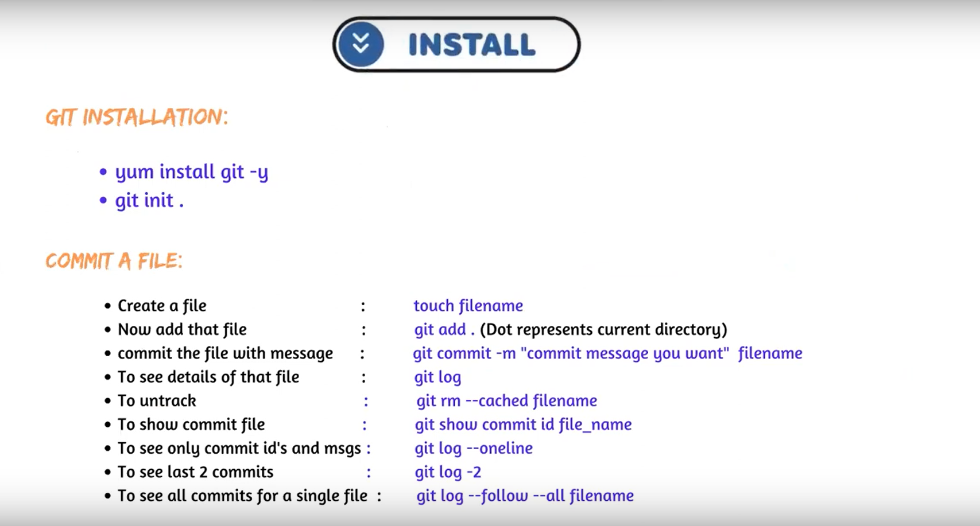

Slide 34
Git INSTALL steps to follow
Before GIT Installation we want to lauch ec2 instance
After launch instance we have to connect putty Or mobax term
After login we enter command “sudo yum update –y”
And after switch ec2 user to Root user with help of command “sudo –I”

Slide 35
GIT INSTALL STEPS TO FOLLOW
Yum install git –y to install git
To check git version “git –-version
And after create a folder “mkdir zomato”
And we have to upload files on zomato folder
Cd zomato/
After enter command to check files “ls –al
To check git folder command “git init .”

